Slide 1
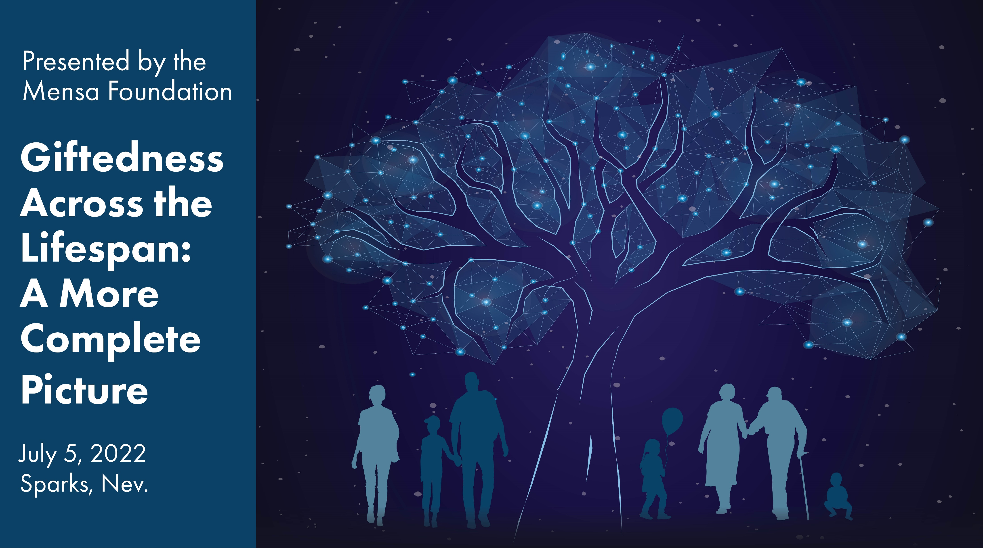

Slide 2



Charlie Steinhice, Mensa Foundation President

Slide 3

Engaging the World and Building the Self
Dr. David Dai

Slide 4
Why Evolving Complexity
Francis Galton (1869): Heritability of Genius
Reductionism in the history of science
Development as Evolving Complexity (Lewis, 2000)
  Emergent novelty
  Increasingly complex
  Going through phase transitions
  Intrinsically robust and extrinsically sensitive (adaptive)
© David Dai

Slide 5
ECT Part 1: Engage the World
Three metaphors
  The octopus metaphor: What develops
  The onion metaphor: How it evolves (with new properties)
  The Marathon metaphor: When and where it unfolds
© David Dai

Slide 6
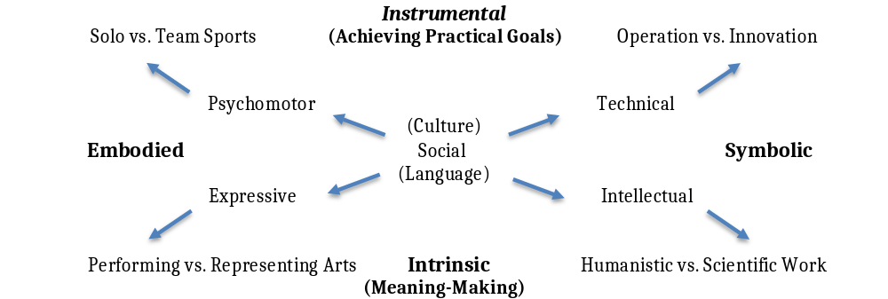
The Octopus Metaphor: What Develops
© David Dai

Slide 7
Evolving Structural Complexities
Increasing differentiation and integration
Domain complexities in terms of harnessing multiple forms of effectivity to achieve a feat
Dynamic person-domain fit: carving a personal niche
Adaptive expertise and creative productivity: Multiple trajectories and pathways
© David Dai

Slide 8
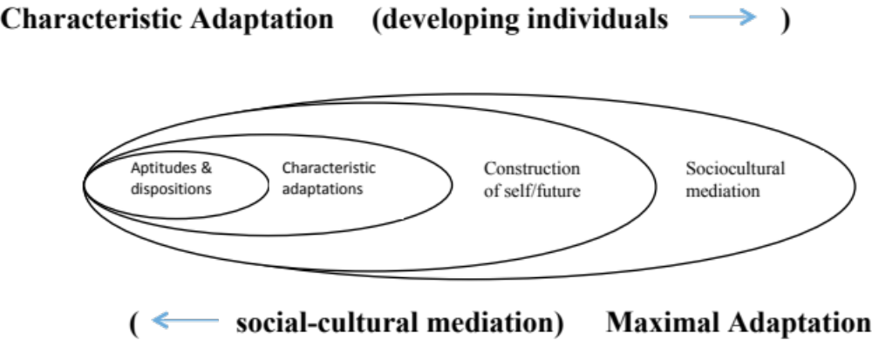
The Onion Metaphor: How the Person Evolves as a Nested Developmental System
© David Dai

Slide 9
Evolving Regulatory Complexities
Circular reaction in early formative, spontaneous phase
  The emergent functional relations
Characteristic Adaptation (CA) in the exploratory phase
  Ease of learning, comparative advantage, and selective affinity
Maximal Adaptation (MA) in the dedicated phase
  Increased demand，social recognition, and identity
CA and MA in the advanced phase
  Perfecting one’s trade, and finding one’s niche (voice)
© David Dai

Slide 10
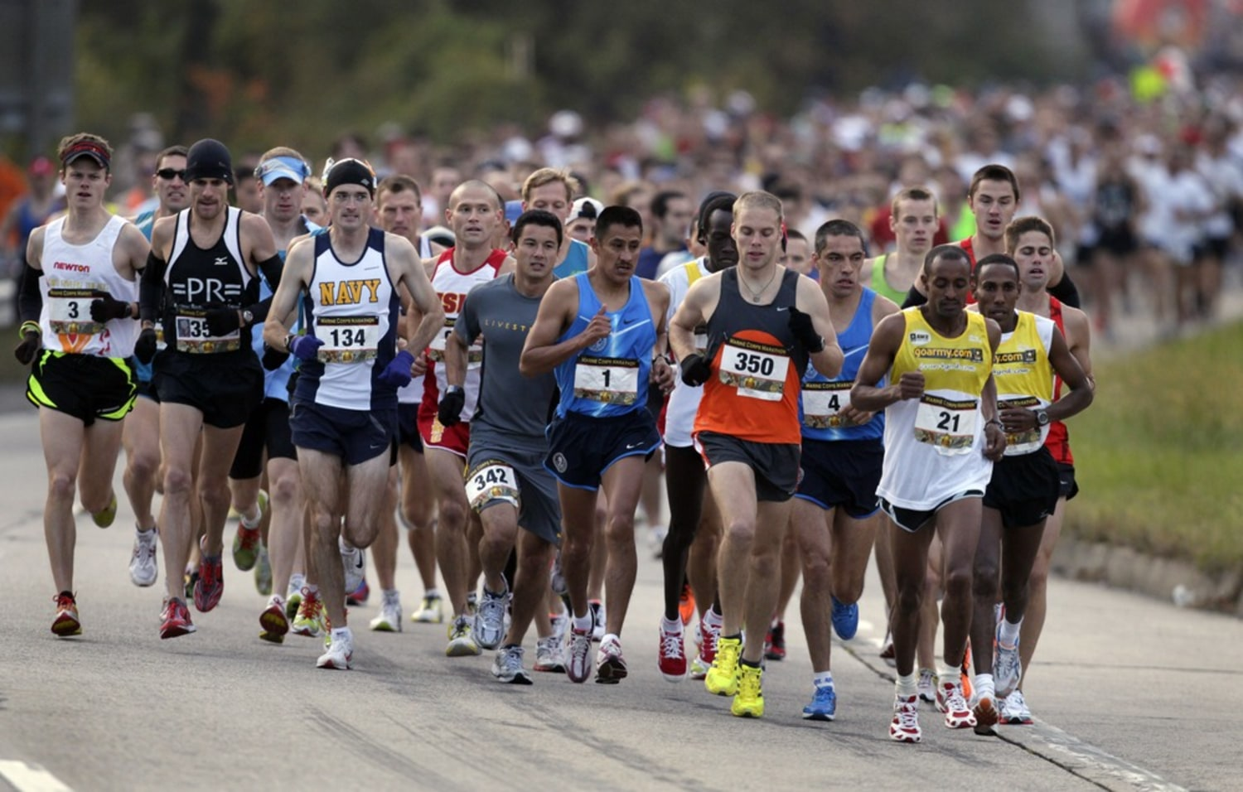
The Marathon Metaphor: When and Where It Unfolds
Onset, learning curve, peak, and decline (TD has its own cycle)
Critical transition points: Make-or-break, milestones, & hurdles
Sustaining power: Transitions to higher levels of TD
© David Dai

Slide 11
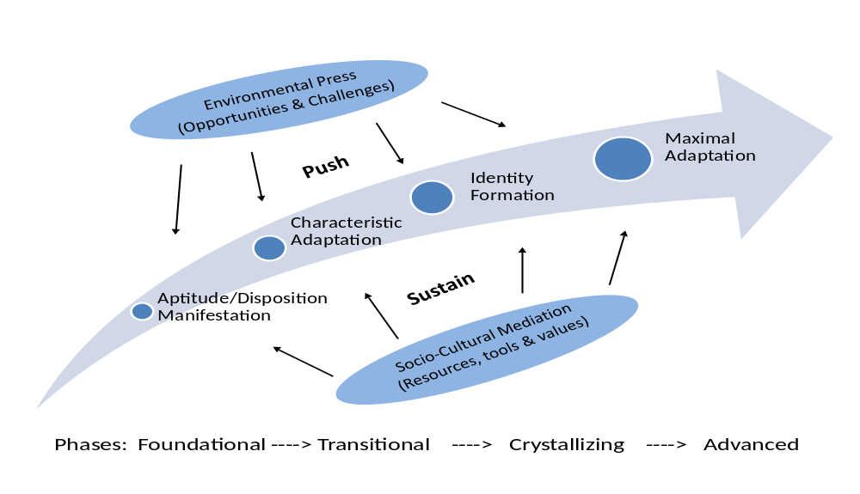
Evolving Temporal - Contextual Complexities
© David Dai

Slide 12
ECT Part 2: Building the Self
Self Development along with Talent Development
  Childhood: Playful engagement and positive affect
  Adolescence: Serious work and self-direction
  Young Adulthood: Crystalizing experience and commitment
  Mid-Adulthood: Perfecting trade and finding a niche (voice)
© David Dai

Slide 13
Dr. Gerald Edelman (1929-2014)
as a case in point
1929 Born to a physician’s family, in Queens, New York (Early enriched environment)
1946 Graduated from High school: Violin or Science? (Serious work and self-direction)
1950 BS, major in chemistry, graduated magna cum laude from Ursinus College
1954 MD medical School Upenn (Crystalizing experience and commitment to a line of work)
1955-56 US Army Medical Service in France (back to US in 1957 to pursue a PhD in medicine)
1960 PhD. Rockefeller Institute 1960 (Niche-picking, Nobel-prize winning work done in 1960’s)
1966 Becomes a professor at Rockefeller Institute
1972 Nobel Prize for Physiology and Medicine, for discovery of antibodies
1970’s-1990’s Working on a biology of consciousness and memory formation and becoming a preeminent neuroscientist (cutting-edge work, staying at the edge of chaos)
© David Dai

Slide 14
Play, Work, and Self
Given our view of higher-order consciousness, this also means an account that explains the bases of how we attain personhood or selfhood. By selfhood, I mean not just the individuality that emerges from genetics or immunology, but the personal individuality that emerges from developmental and social interactions.
-- Gerald M. Edelman (1995, p. 201)
© David Dai

Slide 15
Sum-Up of ECT
Evolving Structural, Regulatory, and Temporal-Contextual Complexities of TD
Engaging (and Constructing) the World and Building the Self are flip sides of the same coin
Being-in-the-World (Heidegger), Intentional Arc (Merleau-Ponti), and Higher-Order Consciousness (Gerald Edelman)
© David Dai

Slide 16
Take-Away Message
Having gifts and talents is a blessing but if you don’t do something with them, nothing is going to happen.
You are not the same person when you are 16 years old as when you were 6; developmental discontinuities do take place, especially when you are deeply engaged with the world.
Surpassing oneself (including not complacent with one’s own success), leaving a legacy, or sheer joy of discovery is a driving force that would stretch one’s limits in domains of human endeavor, be it basketball game or rocket science.
Would a productive life make you happier? Yes, most of the time. One would be more likely proud of what one has achieved than what one possesses.
Eminence is a by-product of your serious work; fame is a good thing, but you cannot live on it. Even if you are a performer, the curtain will eventually fall. The process is more important than outcome.
© David Dai

Slide 17
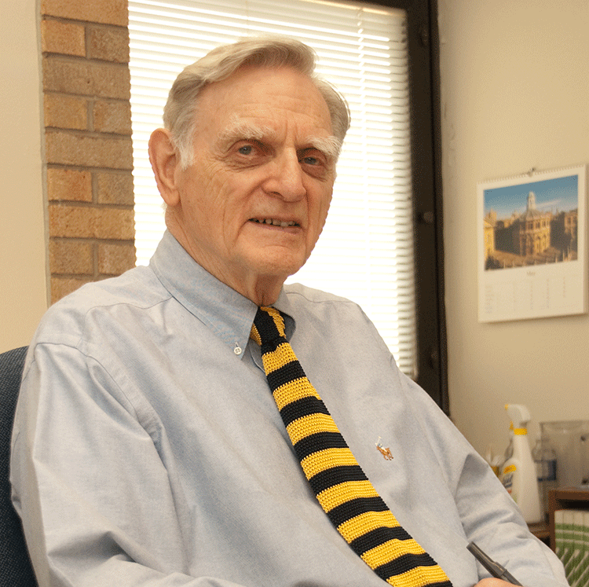
Dr. John Goodenough, 2019 Nobel Prize Winner in Chemistry at the age of 97
Still working at Univ. of Texas as of 2021, at age of 99
Still antsy about making another breakthrough in lithium-ion battery technology
© David Dai

Slide 18
Thanks for Listening
Questions?
ydai@albany.edu
© David Dai

Slide 19
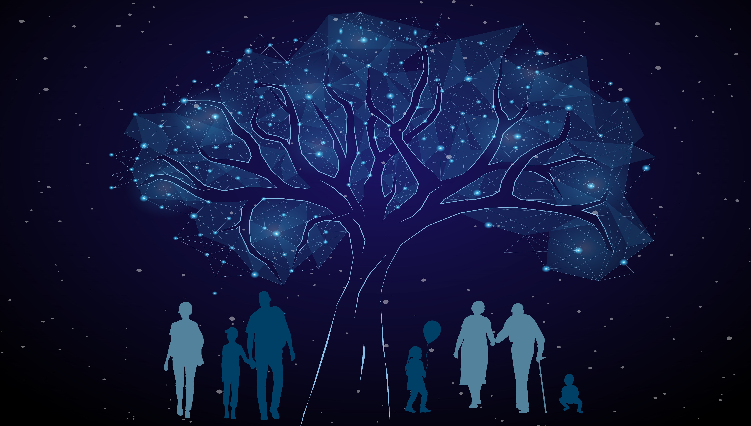
10 Minute Break
Next up: Rianne van de Ven

Slide 20

Gifted Adults at Work
Rianne van de Ven
© Rianne van de Ven

Slide 21
Background Information
Gifted education in the Netherlands
Special education programs for gifted children started 1990’s
Today, identification mostly based on problems
But it is improving!
Adults of today were not identified as gifted children
Are they still gifted?
© Rianne van de Ven

Slide 22
My Personal Story
Smart kid, but dropped out of university
Successful in corporate environment (Telecoms, Banking, IT)
IQ 99th percentile, age 33
Mensa member
Gifted Adults Foundation (www.IHBV.nl)
Social enterprise “Gifted in Company”
© Rianne van de Ven

Slide 23
Gifted Adults: How are they doing?
Educated guess 2009
They psychological and social functioning of gifted adults in the Netherlands
Preparations for meeting with the government
Mensa member
Funding for Gifted Adults Foundation
© Rianne van de Ven

Slide 24
Psychological and Social Functioning of Gifted Adults
© Rianne van de Ven

Slide 25
The importance of identification
Figures for other countries will differ
All countries report parts of the population of gifted children as not identified
In the US: over-representation of white boys in gifted educational programs
Big influence on personal development
© Rianne van de Ven

Slide 26
The not-so-successful group
“I’ve always felt different.”
Low self-esteem.
Not having a meaningful life.
Feeling they have a lot more potential but unable to manage themselves.
Difficulties in choosing – “multi-potentialites”
Perfectionism: fear of failure, procrastination, emotionally intense.
© Rianne van de Ven

Slide 27
Gifted at Work
Qualities
Problems
Skills to improve
Needs
© Rianne van de Ven

Slide 28
Gifted at Work – Qualities
Creativity
Problem solvers
Innovative
Analysis
Manage complex situations
© Rianne van de Ven

Slide 29
Gifted at Work – Problems
Conflict
Bore-out
Burn-out
Need for meaningful contributions
Loneliness
© Rianne van de Ven

Slide 30
Gifted at Work
– Skills to Improve
Self-knowledge
Self-care
Communication
Cooperation
Conflict resolution
© Rianne van de Ven

Slide 31
Gifted at Work
- Needs
Safe environment – empathetic boss
Sparring partners
Autonomy
Diversity in tasks
Complexity in tasks
Personal development / growth at their own pace
© Rianne van de Ven

Slide 32

Gifted Careers
Self-employment (higher satisfaction)
In employment: job-hopping
Jack of all trades
Necklace with beads
Multiple strands
© Rianne van de Ven

Slide 33
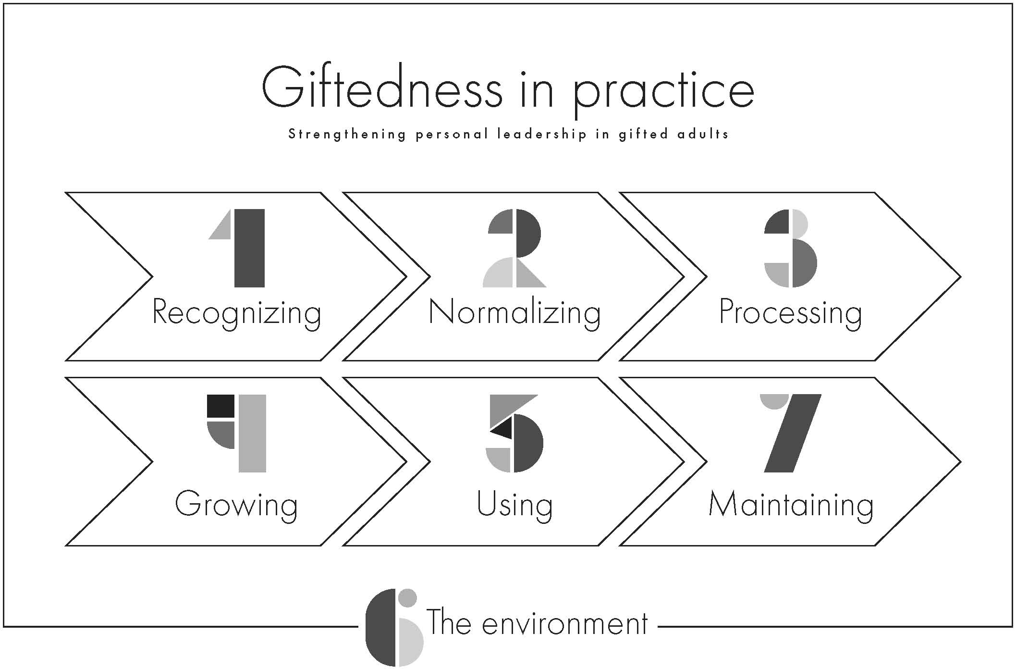
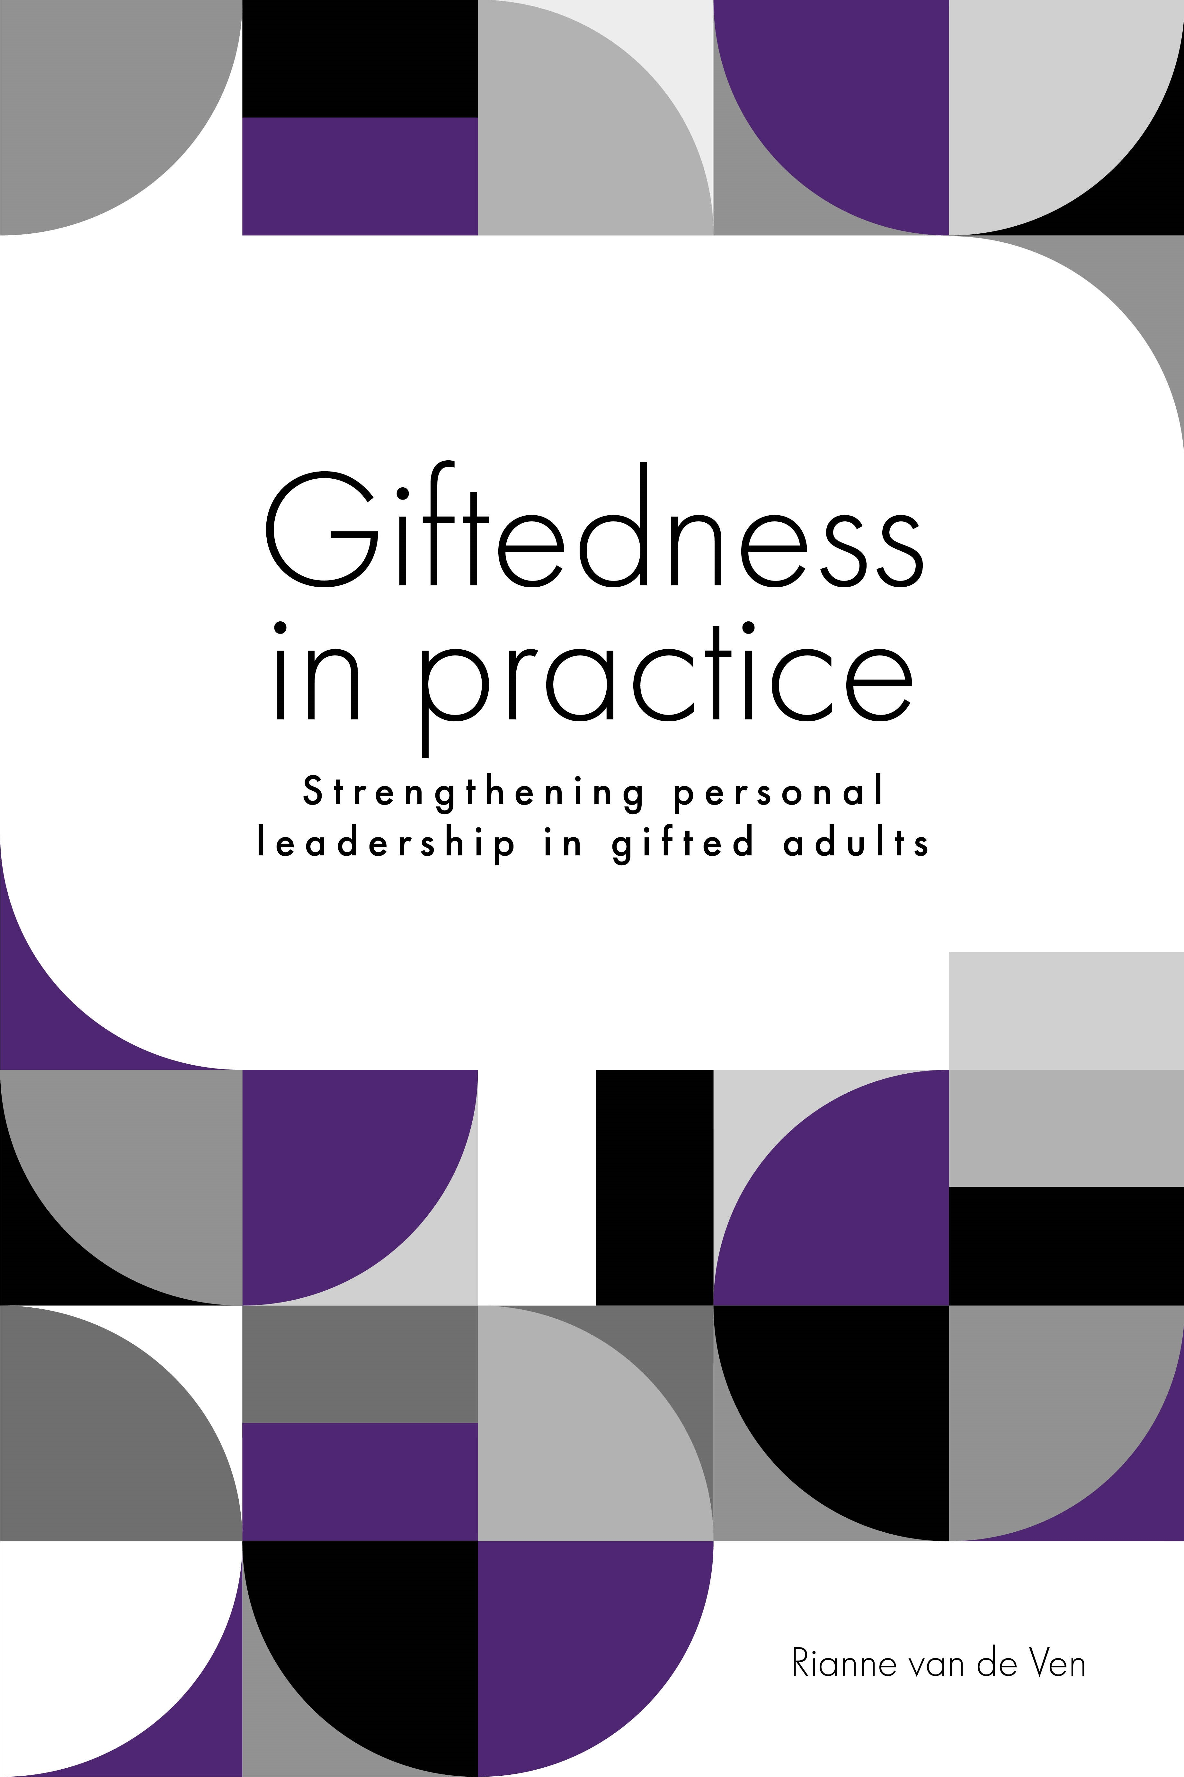
My Work: Professional Coach for Gifted Adults
© Rianne van de Ven

Slide 34
KEY REFERENCES
Elshof A. A., (2016). Gifted and Burnout in the Workplace: A Mixed Methods Study.
Grooff Nick, (2018). The Innovative Work Behaviour of Gifted Adults.
Van der Waal, I., Nauta N., Lindhout R. (2013). Labour Disputes of Gifted Employees.
Van Casteren P., Meerman, J., Brouwers, E., van Dam, A. & van der Klink, J. (2021). How can wellbeing at work and sustainable employability of gifted workers be enhanced? A qualitative study from a capability approach perspective.
Van de Ven, R., van Weerdenburg, M., & van Hoof, E. (2016). Working with intensity; The relationship between giftedness and sensitivity in working adults in Flanders and the Netherlands. Unpublished manuscript. Retrieved from https://riannevdven.nl.publicaties/working-with-intensity/
Vreys, C., Venderickx, K., & Kieboom, T. (2016). The Strengths, Needs and Vulnerabilities of Gifted Employees. International Journal for Talent Development and Creativity, 4(1), 51–62.
© Rianne van de Ven

Slide 35
Lunch Break
Back at 1:30 PM PDT
Next Up: Dr. Maggie Brown

Slide 36
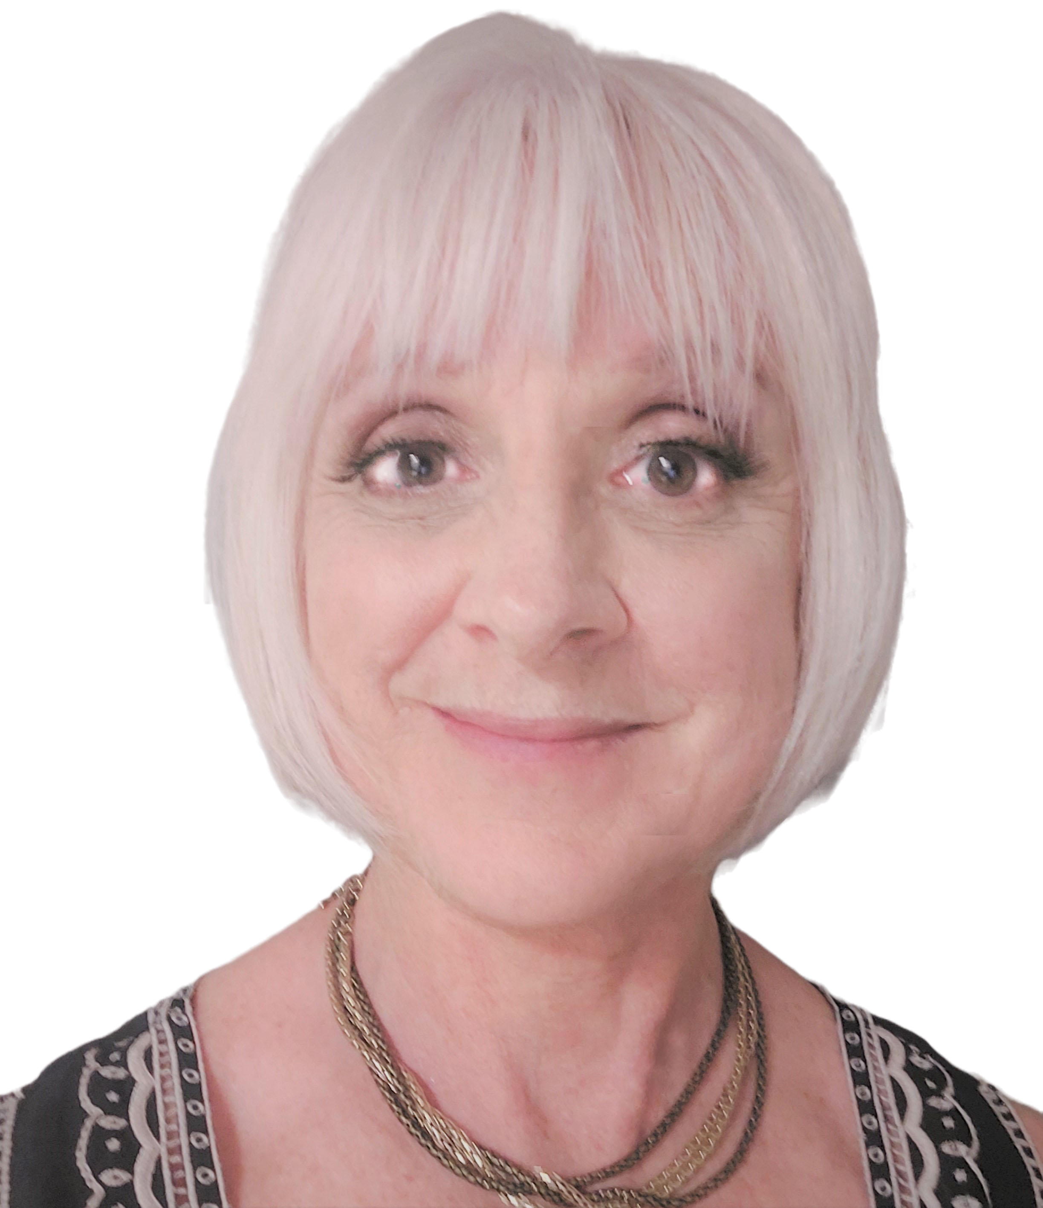
Adults: Intelligence, Gifts, & Wellbeing
Dr. Maggie Brown

Slide 37


Crafting a life that works
Living a life worth living
© Maggie Brown

Slide 38

Expand our Stories:
More than just ‘the individual’
More than cognitive processes and abilities
Beyond a single emphasis on achievement
Why?
© Maggie Brown

Slide 39

Our own health, and our mental health, in particular, is intimately connected to our experiences of the world –
It is not just about what happens inside this container called ‘me’.
© Maggie Brown

Slide 40

MENTAL WELLNESS
Finding & fostering lasting connections in our lives
Learning & growing
Nurturing healthy relationships of all kinds
Feeling acknowledged & supported for what we value & the work we do
Feeling a sense of security & Ok-ness
For many gifted adults, these simple things can seem so complicated to achieve.
And yet they are proving to be essential for living a healthy and contented life
© Maggie Brown

Slide 41

Today:
Underground
What topics and issues have been underground and why?
Emerging
Questions
What is being asked, uncovered and discovered?
Next
What needs to be done to build knowledge moving forward?
What is now being brought to light, and by whom?
THE G WORD
© Maggie Brown

Slide 42
Underground
What topics and issues have been underground and why?
Underground:
People’s experiences of life – on a daily basis, in the many contexts of adulthood.
Literature Reviews: Brown (2021); Rinn & Bishop (2015)
Heritability
Effects of early education
Career goals & counselling
Education & career success
Domain specific talent development
Women’s achievement
Those ‘simple things’ that are proving to be essential for living a healthy and contented life
SEEN
© Maggie Brown

Slide 43
Underground
What topics and issues have been underground and why?
Underground:
People’s experiences of life – on a daily basis, in the many contexts of adulthood.
Delphi Study with 76 “Gifted Adults” Experts:
Those ‘simple things’ that are proving to be essential for living a healthy and contented life
Most concepts come from the study of children & gifted education.
Concepts related to intelligence & adults are narrow. MISS A LOT!
© Maggie Brown

Slide 44
Emerging:
Emerging
What is now being brought to light??
Underground
New interest and information about experiences, problems, joys & activities across the many years, stages and contexts of life post-childhood
New interest in understanding & sharing information about real lived experiences:
Roles
Relationships
Mental health
Work
Leisure
© Maggie Brown

Slide 45
Emerging:
Emerging
What is now being brought to light, and by whom?
Underground
New interest and information about experiences, problems, joys & activities across the many years, stages and contexts of life post-childhood
Mental health professionals
Gifted adults themselves: privately, social media, interest groups
(SOME researchers and academics)
© Maggie Brown

Slide 46
Who is interested?
?
Researchers
We are not that!
Subthemes | Excerpt
Trapped by the usual narratives | I don’t know how to talk about what it’s like to be gifted. For me it’s not about IQ and being at the top, but those are the words being used. It’s so much more!
Othering: out of place & somehow wrong | It was bad enough to be different when I was a kid. But now? How can I explain being different? If I say I’m gifted, I’m seen as arrogant. But if I don’t say that, then I’m just a freak.
Values are being imposed | Eminence? [groans]. That’s what someone else expects. I really don’t care and don’t want it.
Individuals
Focus
Groups
Mental Health
Professionals
Gifted Adults
Social Media
Interest
Groups
© Maggie Brown

Slide 47
Questions:
Underground
Emerging
Questions
What is being asked, uncovered & discovered?
New people asking questions and raising issues about mental health & wellbeing in contexts of adult life.
Some specific questions & issues:
Interpersonal: Relating
Intra-personal: Identity
Social: Values
Friendship | Citizen
Employment | Aging
Higher Education | Under-employment
Lifelong Learning | Illness
Parent Role | Immigrant
Spouse | Newly Single
Earner & breadwinner | Leader & mentor
Manager | Caregiver
© Maggie Brown

Slide 48

The interpersonal:
RELATING
Difficulty finding & sustaining meaningful relationships:
Myth of infallibility
Actual problems & solutions
Social/relational preferences
© Maggie Brown

Slide 49



Some relational preferences:
Magic
“Fit”
Boreout vs Burnout
“Those connections when ideas fly! We build on each other – interrupt constantly, finish each others’ sentence, disagree, agree, argue . . . It doesn’t matter!”
“I can sometimes focus for hours – doing what I love and getting deeper and deeper into the experience. It energizes me! Tired but nourished!”
“Small talk? Forget it!”
© Maggie Brown

Slide 50

The interpersonal:
RELATING
Loneliness:
Myth of the solitary genius
Solitude vs disconnections
Prevention
© Maggie Brown

Slide 51
Loneliness: What is emerging:
Emotional Regulation
Early
Intervention
Intentional Networks
2e
Personal Qualities
Nervous system arousal & social functioning
Mindfulness
Interpersonal neurobiology: early attachment
Online groups for gifted adults
New organizations
Broadening the scope of existing groups
Gifted ed programs
Family support and training
Universities
Public awareness
Relational trauma
ASD
ADHD
Other learning or social differences
Social anxiety
© Maggie Brown

Slide 52

The
intrapersonal:
IDENTITY & OK’NESS
Misperceptions & misdiagnoses
Inner narrative: depathologize, validate & affirm
Sensitivities, intensities, complexities
Art by: Jannick Deslauriers
“To be thin-skinned, far-sighted and loose-tongued . . . is to feel too sharply, see too clearly,
speak too freely…”
© Maggie Brown

Slide 53

The social:
VALUES & ASPIRATIONS
Emerging priorities challenge assumptions
Complex, & preference to ‘dive deep’ into wicked problems
Existential crises and TPD
Collaboration
To craft a life that works,
To live a life worth living.
© Maggie Brown

Slide 54
Next:
Underground
What topics and issues have been underground and why?
Emerging
Questions
What is being asked, uncovered and discovered?
Next
What needs to be done to build knowledge moving forward?
What is now being brought to light, and by whom?
Broaden: person in context(s)
Challenge the myths: infallibility, loner, aspirations
Raise awareness
Provide opportunities to connect
Support grassroots research
© Maggie Brown

Slide 55
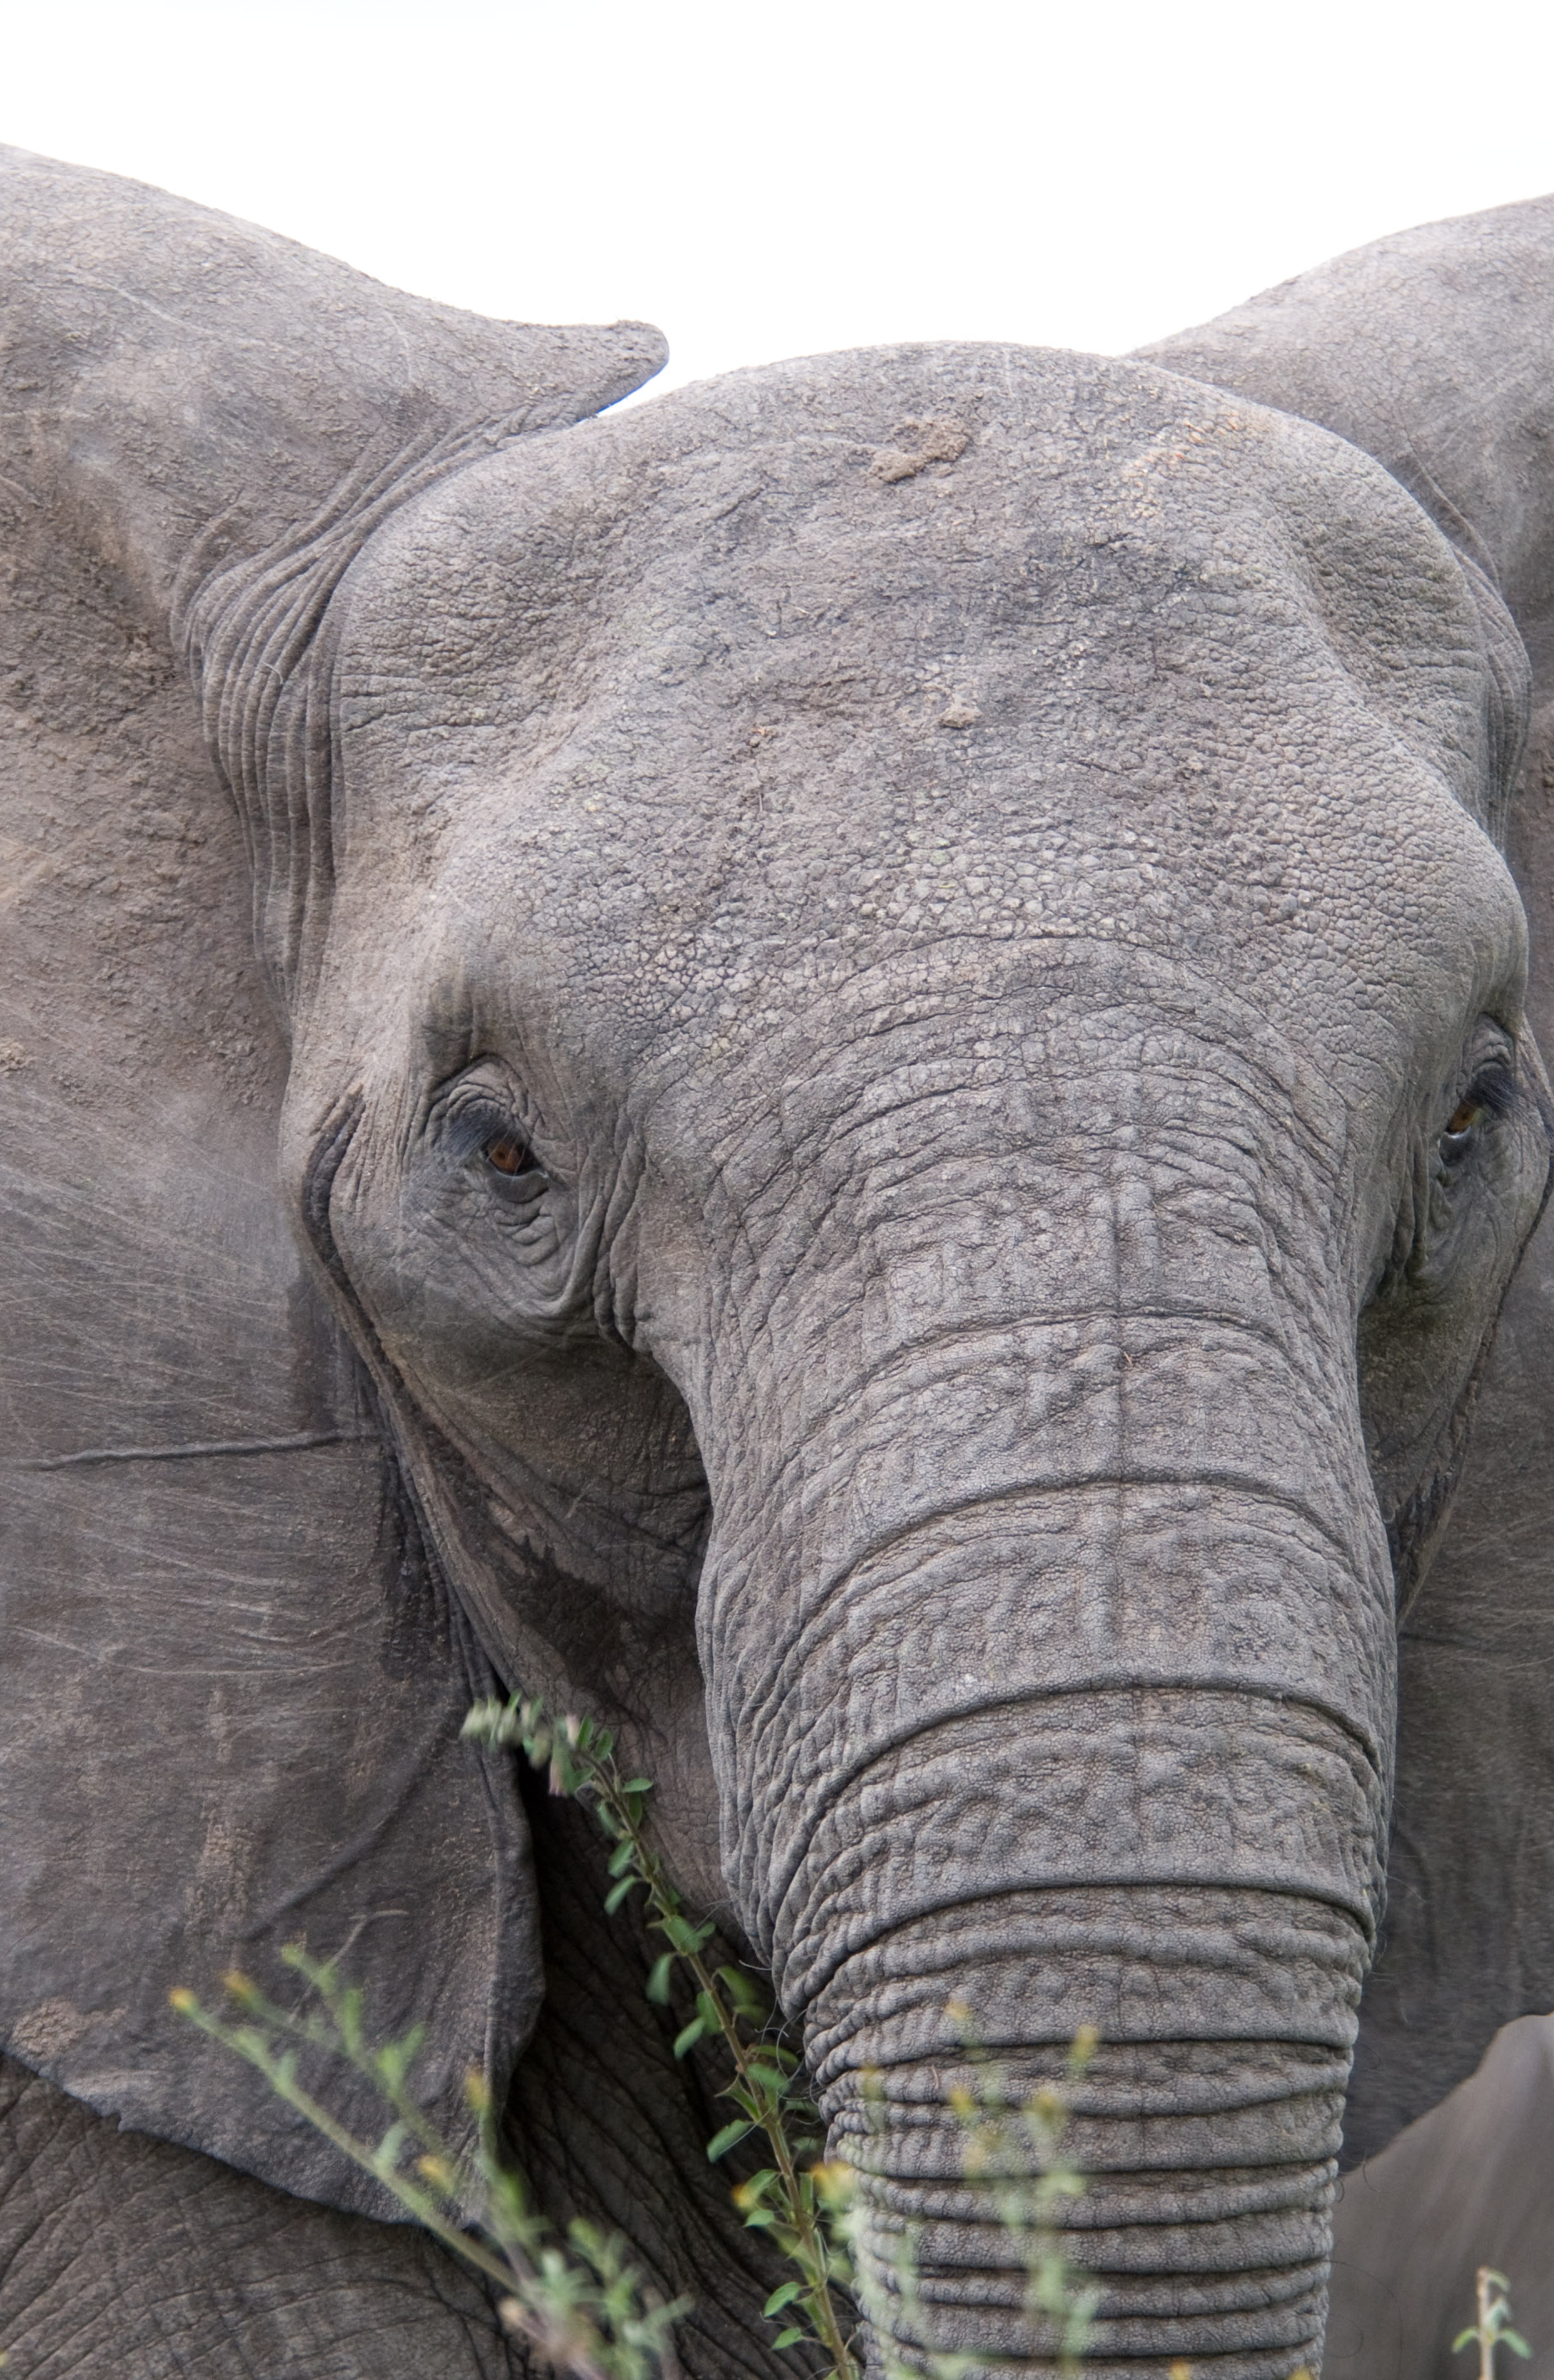
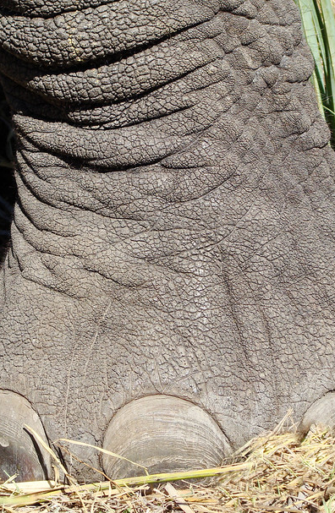

“Conversations are powerful…”
They can turn us toward different definitions & different pathways.
They help us look at complicated matters from different perspectives as we turn them this way & that.
Striving to construct a new understanding.”
© Maggie Brown

Slide 56
KEY REFERENCES
Brown, M. (2021). Research with gifted adults: Mapping the territory using a socially just process. {Doctoral Thesis, The University of Auckland]. ResearchSpace@Auckland. https://hdl.handle.net/2292/54761 (Including Literature Review)
Brown, M., & Peterson, E. R. (2020). “We are not that!”: A focus group study with gifted adults. Advanced Development, 18, 107-127. (Focus Group Study)
Brown, M., & Peterson, E. R., (2022) Current approaches to research with gifted adults: Differences known and unknown. Roeper Review, 6-18. https://doi.org/10.1080/02783193.2021.2005207 (Delphi Study Results)
Brown, M., Peterson, E. R., & Rawlinson, C. (2020). Research with gifted adults: What international experts think needs to happen to move the field forward. Roeper Review, 42(2), 95-108. https://doi.org/10.1080/02783193.2020.1728797 (Delphi Study)
Elder, H. (2020). Aroha: Māori wisdom for a contented life lived in harmony with our planet. Penguin.
Grobman, J. (2009). A psychodynamic psychotherapy approach to the emotional problems of exceptionally and profoundly gifted adolescents and adults: A psychiatrist's experience. Journal for the Education of the Gifted, 33(1), 106-125.
Kuipers, W. (2010). Enjoying the gift of being uncommon: Extra intelligent, intense and effective. CreateSpace.
Rinn, A. N., & Bishop, J. (2015). Gifted adults. Gifted Child Quarterly, 59(4), 213-235. https://doi.org/10.1177/0016986215600795 (Literature Review)

Slide 57
Thank you!
PLEASE CONNECT!
Dr. Maggie Brown: Psychotherapist
www.maggiebrown.co
maggie.brown@aut.ac.nz
© Maggie Brown

Slide 58
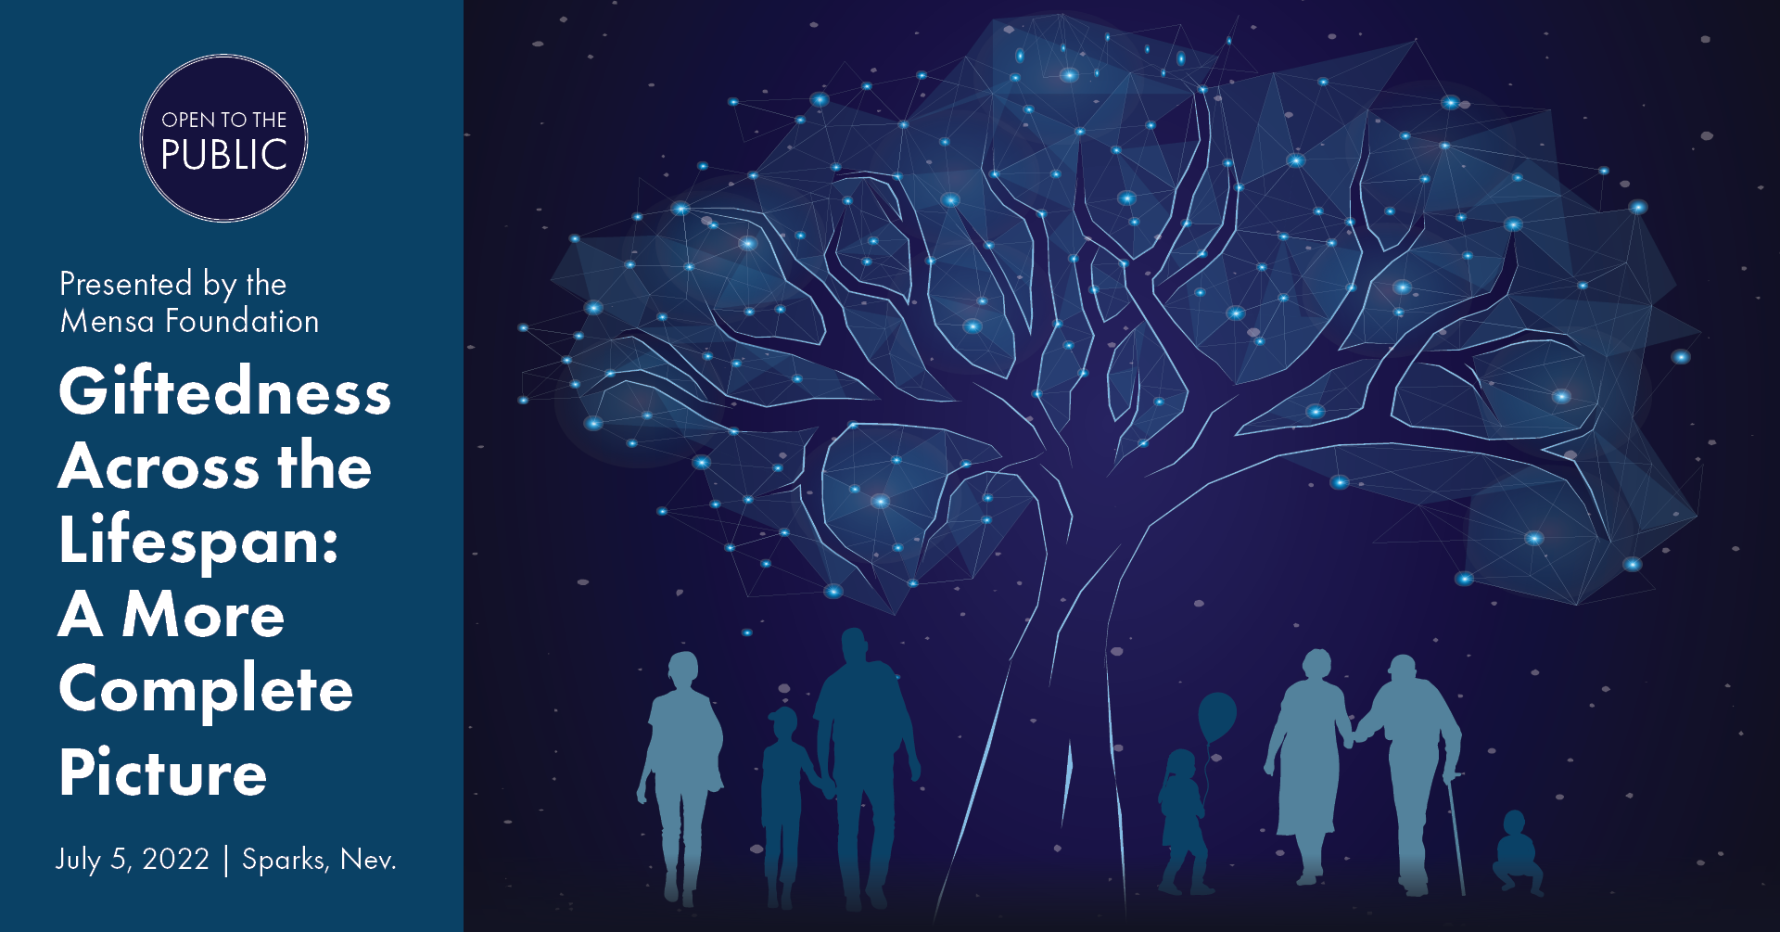
10 Minute Break
Next up: Dr. Ellen Fiedler

Slide 59
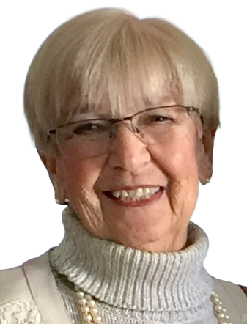
Stormy Seas or Smooth Sailing? Being Gifted During Life’s Later Years
Dr. Ellen Fiedler
© Ellen Fiedler

Slide 60
Why do I care about gifted adults, including those who are “older?”
Speaking from my heart.
A word or two about the title of my presentation …..
Think about and consider what I’ll be talking about as well as what the others have discussed today.
Good to have conversations about all of this!
Disclaimer about generalizations that I’ll be making.
  Perfectly fine for you to be thinking “yes, but…..”
© Rianne van de Ven

Slide 61

You don’t outgrow giftedness!
Gifted children become gifted adults.
Giftedness is part and parcel of who someone is at every age and stage of life.
My focus today is on older gifted adults – a typically forgotten group of gifted individuals.

Slide 62
Looking at Perspectives on Giftedness: Food for Thought and Discussion
IQ does provide some helpful information, but ……
The “Columbus Group definition – a useful perspective that includes:
  Asynchronous development
  Advanced cognitive abilities and heightened intensity
  The result: qualitatively different inner experiences and awareness that are different from the norm
  Renders the gifted particularly vulnerable (regardless of age)
Annemarie Roeper’s definition: Another “inside view” of giftedness including greater sensitivity and a greater ability to understand and transform perceptions into intellectual and emotional experiences
These definitions go well beyond performance-based views that often haunt gifted adults throughout life

Slide 63
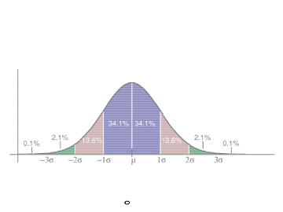
Then and now ? ? ?
Historically, the intellectual and academic achievements of gifted children have been emphasized, with very little attention paid to gifted adults … until recently.

Slide 64
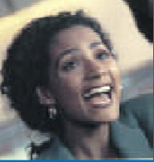
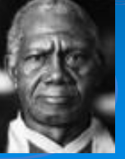
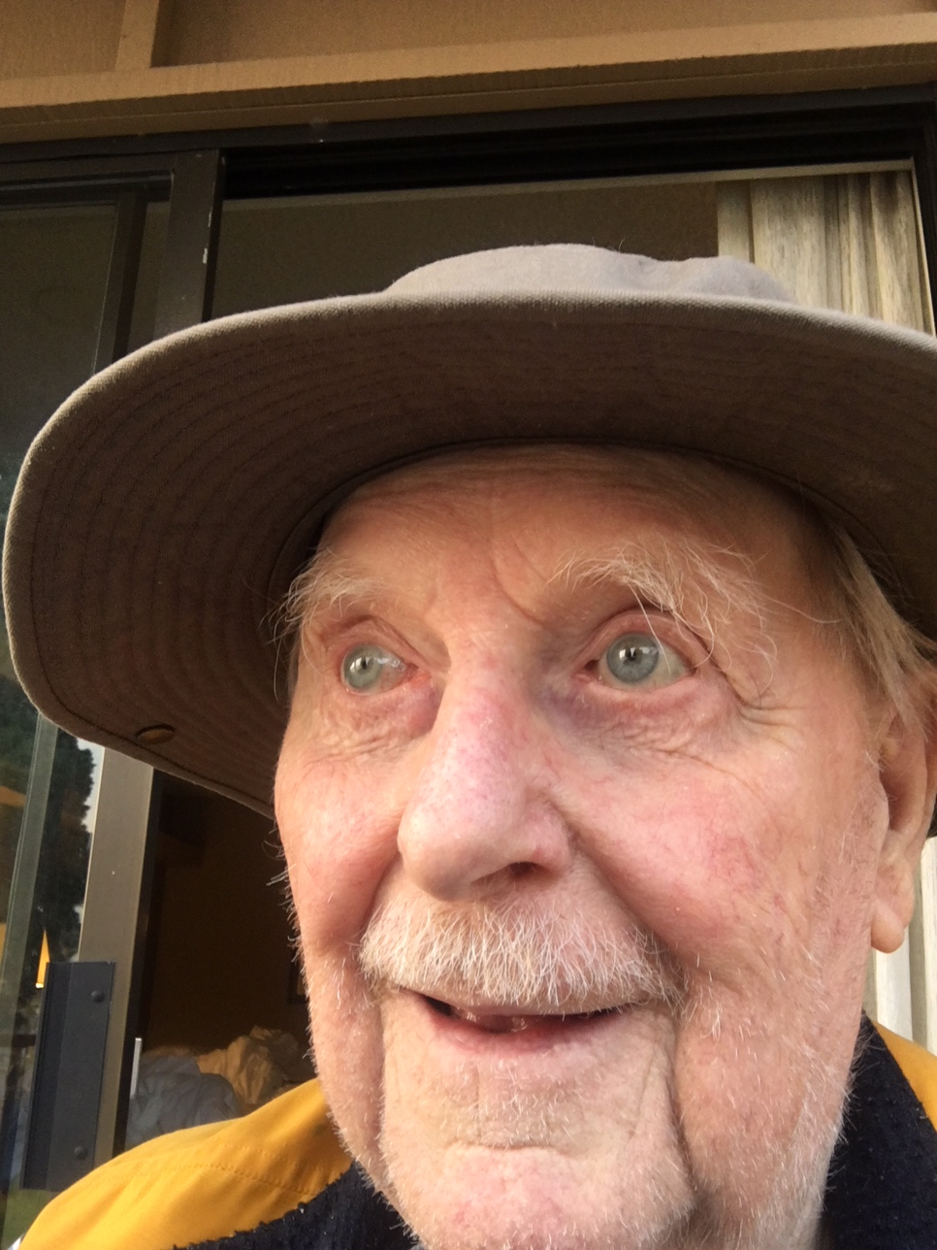
You Don’t Outgrow It!
The Journey Through Life’s Later Years
My model (adapted from Erik Erikson’s work)
incudes three stages for older gifted adults (as well as three stages for younger gifted adults):
  Navigators—Approximately ages 50-65
  Actualizers—Approximately ages 65-80
  Cruisers—Approximately 80 and beyond
(Slide adapted from: Fiedler & Webb, 2011)

Slide 65
One more category:
The Invisible Ones
Adults so far into denial that their giftedness becomes invisible,
Those whose giftedness has never been readily apparent,
Adults who choose paths that don’t necessarily rely on validation by others, or
Those who consciously choose to hide who they really are
  .
  Bright/creative/gifted adults can “go chameleon” at any age or stage of life

Slide 66
One more category:
The Invisible Ones
Adults so far into denial that their giftedness becomes invisible,
Those whose giftedness has never been readily apparent,
Adults who choose paths that don’t necessarily rely on validation by others, or
Those who consciously choose to hide who they really are
  .
  Bright/creative/gifted adults can “go chameleon” at any age or stage of life

Slide 67
One stage at a time: Issues and more…
  Navigators: (Approximately ages 50-65)
      Coping with conflicting feelings and being out of sync with others
      Using prior knowledge, including self-knowledge
      Dealing with dissatisfaction
      Balancing everything in their busy lives
      Drawn to setting a new course in life

Slide 68
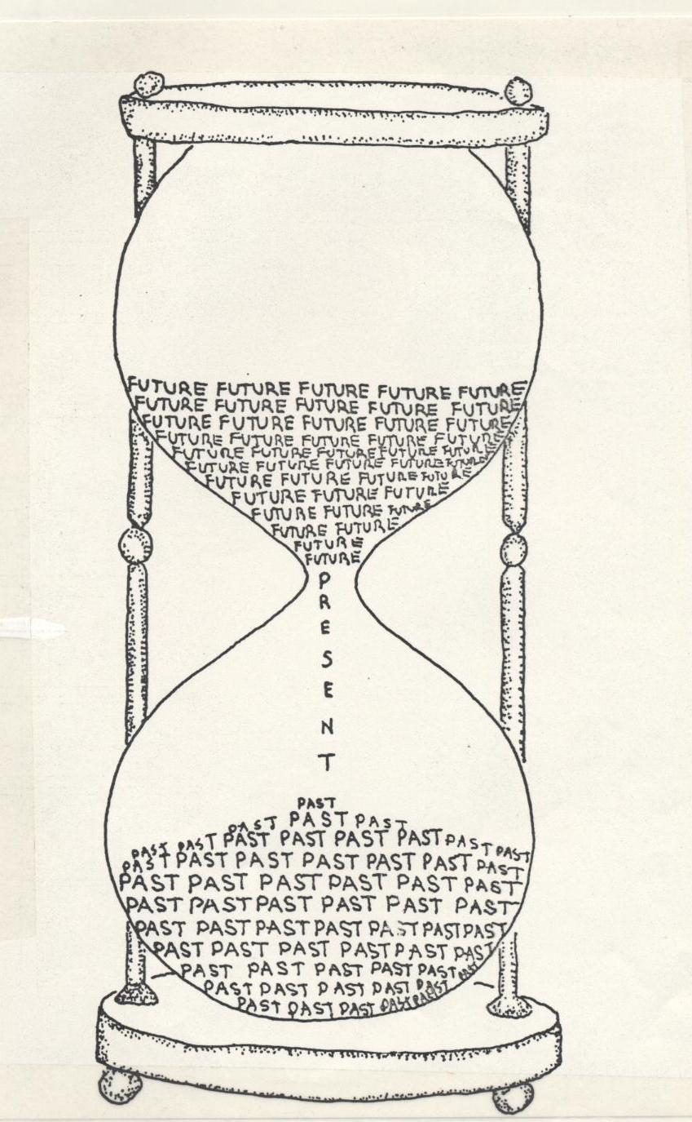
Being an older gifted adult often means…
A keen awareness and
impatience with time
and space limitations;
frustration with
multi-potentiality
(Adapted from: Fiedler & Webb, 2011)

Slide 69
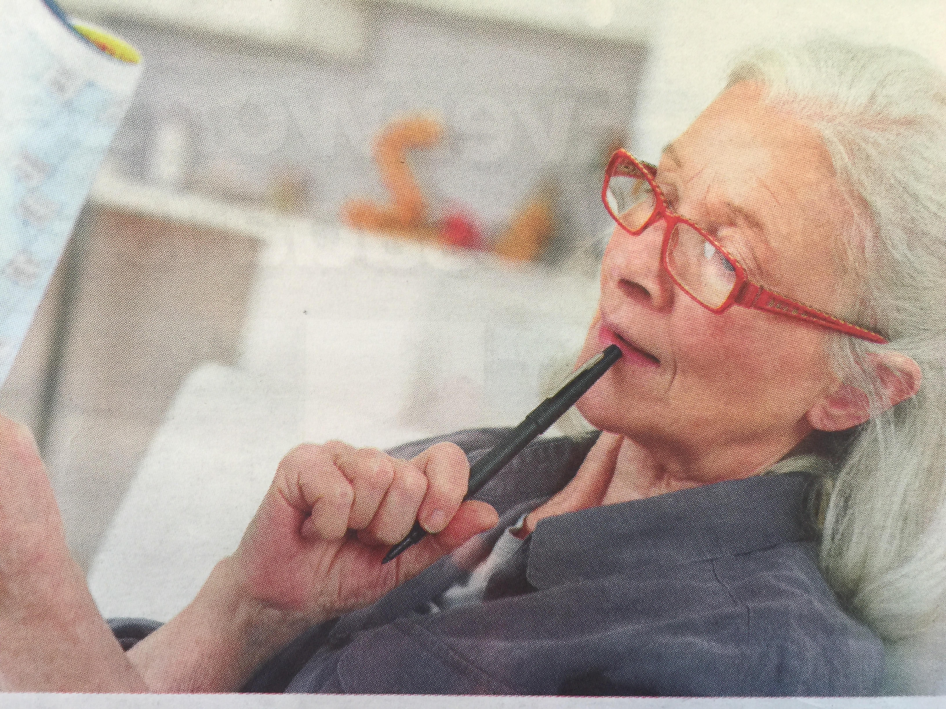
Navigators (ages 50-65) – a few real-life examples
Elise – Job eliminated; now what?
Steven – company downsizing; an opportunity for the future?
Cassandra – taking action on an unlived dream

Slide 70
Some Key Issues for Actualizers:
Mid-life “crisis” or mid-life quest?
  Actualizers: (Approximately ages 65-80)
      Pursuing self-actualization + helping others actualize their potential and pursue their goals and dreams
      Connecting with others like them
      Introspection and reflection
      Keeping on or moving on
      Continuing to expand their knowledge
      Generativity

Slide 71
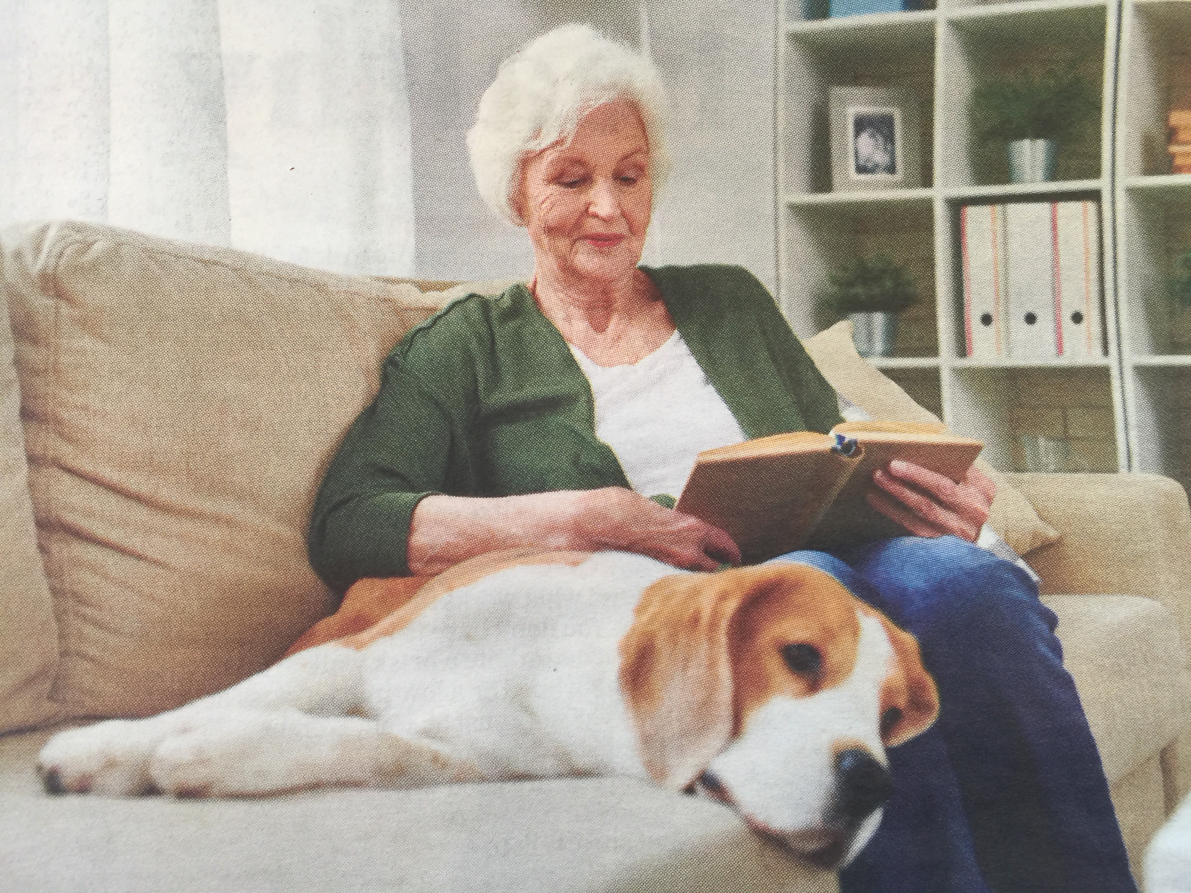
Actualizers (ages 50-65): A few real-life examples
Greg – a physical therapist’s next steps
Sarah – new direction for communication
Elizabeth – shifting gears

Slide 72
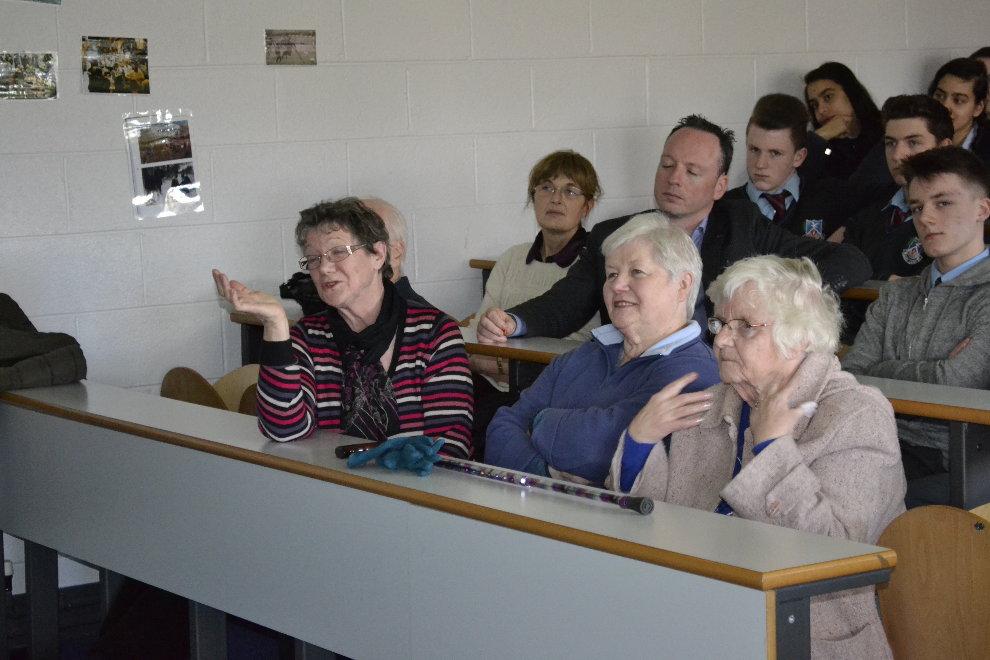
Some Key Issues for Cruisers (age 80 and beyond)
  Cruisers: (Approximately 80 and beyond)
      Doing what they can to continue to have vibrant, interesting lives
      Choosing how to spend their time and energy
      Dealing with physical changes
      Needing to exercise their minds
      Having meaningful relationships with others
      Remaining independent as long as possible
      Generativity

Slide 73
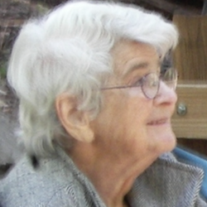
Cruisers (age 80 and beyond):
A few real-life examples
Fred – growing new directions for his life
Barbara – coping with her own “energy crisis“
Annemarie – dealing with ageism while keeping on doing her life’s work

Slide 74
Cruisers: “Role Model”/“Elder” or ……
How do you feel about being either a “role model” or an “elder?”
Get a warm and fuzzy feeling—a sense of validation? Or, is it intimating to be expected to live up to those labels.
Many Cruisers object to being labelled ”elders” – thinking it’s a subtle allusion to being “elderly.” They don’t see themselves as elderly at all – at the most, “ageless”.
Many Cruisers express discomfort with being seen as wiser than anyone else; they see themselves as continuing find their way in life.

Slide 75
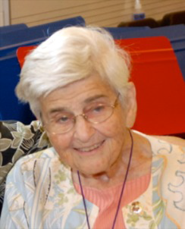
Insights from Annemarie Roeper, an ageless elder in gifted education:
“…upon arrival in one’s early 80s, the road one has been traveling, which, up until now had been relatively well lit, well described, and well worn, begins to peter out, until one is left standing in a field, no longer sure of the way.”
(Roeper, 2011, p.16)

Slide 76
Ageless…..
Intensity, enthusiasm for learning, creativity, and childlike delight in new ideas and beautiful sights, sounds, and all kinds of other experiences.
Young-old vs. old-old: (Thoughts adapted from Pipher,1999)
  She suggested that the change from being young-old to being old-old is loss of health.
    However, other factors may come into play: Whether their health issues are fairly temporary with the prospect of full recovery or
    If the prognosis is for long-term increasing debilitation
Optimism affects how Cruisers respond to health concerns (and other aspects of their lives).
Cruisers often use their intellectual abilities and core beliefs to make it through.
May still need to navigate a storm of intense emotions before moving forward.

Slide 77
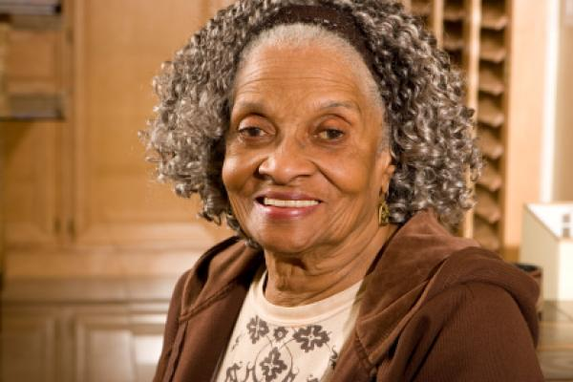
The Third Chapter: 25 Years After 50
  (((Thoughts from Lawrence-Lightfoot, 2009)
From “making a living to leaving a legacy”; mentor, supporter, guide roles shift
Experience vulnerabilities with new learning and discovering a new voice (rookie status?)
Challenge cultural priorities that previously defined life
Time to “unlearn”; e.g. ask for help, go slow, trust your intuition, listen to your body attentively

Slide 78

Distinction between “young-old” and “old-old”*
Beliefs and attitudes
Optimism
Self-perceptions
Accessing stimulating opportunities
Loss of health – temporary versus permanent
* Expanded from ideas in Mary Pipher’s 1999 book, Another Country: Navigating the Emotional Terrain of our Elders.

Slide 79
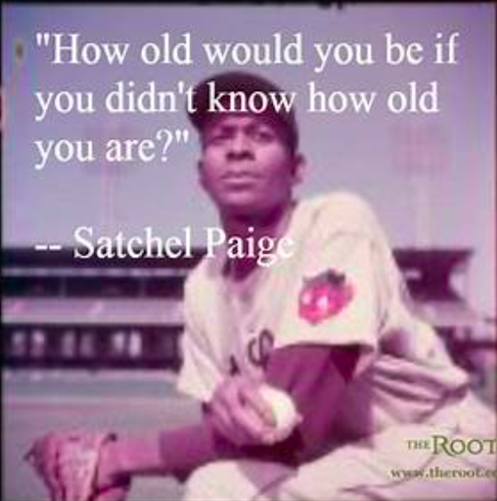

Slide 80
Your age & why you may not feel the age you are.
“The majority of neurons in your brain today are as old as you are. This longevity of the neurons partially accounts for why we feel pretty much the same on the inside at the age of 10 as we do at age 30 or 77. The cells in our brain are the same but over time their connections change based upon their/our experience.”
(Neuroanatomist & brain researcher, Jill Bolte Taylor, 2006, p. 13)

Slide 81
The Invisible Ones – Complex Causes
  Families who didn’t understand or value their types of abilities and/or didn’t support the social/emotional aspects of their giftedness
  Being criticized repeatedly for behaviors accompanying giftedness
  Negative effects of preconceived ideas that others have of them
  Facing unwanted indoctrination
  Aftereffects of physical, sexual, or psychological abuse
  Lost interest in pursuing possible futures predicted for them
  Special needs: Learning disabilities, ADHD, autism spectrum or other conditions that limit their ability to achieve (2e)
  Gender issues & accompanying expectations for each: men & women

Slide 82
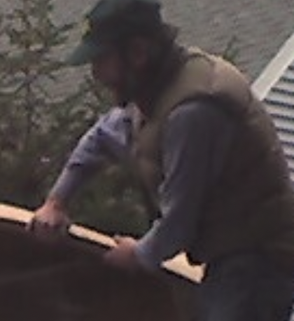
The Invisible Ones – a few real-life examples
George – a subsistence sort of life
Roberta – major shift in her life view
Bob – so many choices, so little time

Slide 83
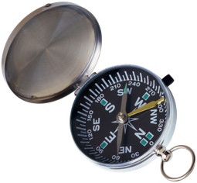
Setting a Course in Turbulent Times
Implications of giftedness for navigating life’s difficult challenges these days
  Related to the characteristics that distinguish gifted adults from others – e.g., complex thinking abilities, intensities and sensitivities
Tough decisions are significantly affected by deep concerns about COVID and other life-threatening illnesses, as well as
  Political, environmental, economic, and societal issues and their implications
More likely than others to suffer from decision fatigue and anxiety about local, national, and international events
Gifted adults’ inclination to be analytical have significant effects on their responses.
  Likely to consider every aspect and ramification of each situation they encounter in today’s troubled and troubling times.
  Often have conflicts with people whose views differ significantly from theirs.

Slide 84
Some Coping Strategies during Turbulent Times
Important to find ways of connecting with others, e.g.:
  Technology
  Telephone calls
  Snail mail
  Meetings and events via Zoom, Skype or other platforms
  Create/participate remotely in organizations of interest (e.g., a book club, camera club, an environmental activist groups, etc.)
Some options create major obstacles for those older gifted adults who aren’t tech-savvy or don’t have access to the devices they need.

Slide 85
Issues & Needs for Gifted Adults Throughout Their Lives
Acceptance
Finding kindred spirits
Strategies for living with intensity
Opportunities for significant challenge
Access to resources
Seeking and finding meaning in life

Slide 86

A thought to ponder as we “stop for now” . . .
  “Sometimes in the waves of change we end up finding our true direction.”
  (Seen on the chalkboard at a coffee house in South Haven, Michigan – 6-22-22,)

Slide 87
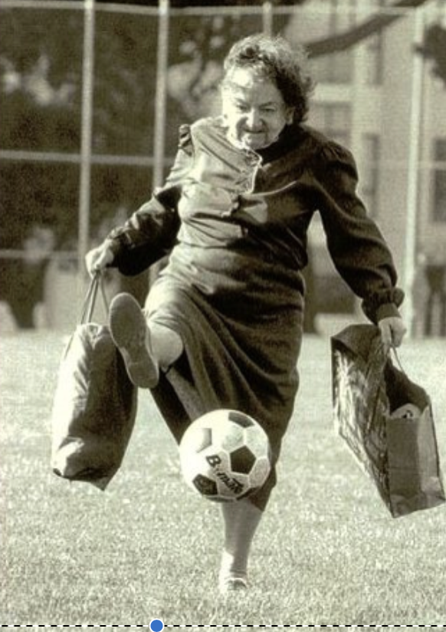
You can’t help getting older . . .
But you don’t have to get old.
--George Burns

Slide 88
Some Books with Stories of Successful Aging
Composing a Further Life: The Age of Active Wisdom by Mary Catherine Bateson
The Blue Zones: 9 Lessons for Living Longer from the People Who’ve Lived the Longest by Dan Buettner
The Longevity Prescription: The 8 Proven Keys to a Long, Healthy Life by Robert N. Butler
The Mature Mind: The Positive Power of the Aging Brain by Gene D. Cohen
If I Live to be 100: Lessons from the Centenarians by Neenah Ellis
Finding Meaning in the Second Half of Life by James Hollis
The Third Chapter by Sara Lawrence-Lightfoot
Your Life Calling: Reimagining the Rest of Your Life by Jane Pauley

Slide 89
A few selected references
Erikson, E. (1951. Childhood and society. New York: W. W. Norton.
Fiedler, E D. (2015). Bright adults: Uniqueness and belonging across the lifespan. Tucson, AZ: Great Potential Press, Inc.
Fiedler, E. D. (2013). You don’t outgrow it! Giftedness across the lifespan. In C. S. Neville, M. M. Piechowski, & S. S. Tolan (Eds.), Off the charts: Asynchrony and the gifted child, pp. 183-210. Unionville, NY: Royal Fireworks Press. (Originally published in Advanced Development: Fiedler, E. D. (2012). You don’t outgrow it! Giftedness across the lifespan. Advanced Development, 13, 19-37.
Fiedler, E. D. & Webb, J. (2111, November. Adult gifted: You don’t just outgrow it! Advantages and challenges of lifespan intensity. Presentation at the 58th Annual Convention of the National Association for Gifted Children New Orleans, LA.
Kane, M. (2009). Annemarie Roeper: Nearly a century with giftedness. In S. Daniels & M. M. Piechowski (Eds.), Living with intensity: Understanding the sensitivity, excitability, and emotional development of gifted children, adolescents, and adults (pp. 185-202). Scottsdale, AZ: Great Potential Press.

Slide 90
And a few more . . .
Kane, M. & Fiedler, E. D. (2019, April). Giftedness is a lifelong journey. SENGinar (webinar) for the SENG organization (Supporting Emotional Needs of the Gifted).
Lawrence-Lightfoot, S. (2009). The third chapter: Passion, risk, and adventure in the 25 years after 50. New York: Sarah Crichton Books.
Maslow, A. H. (1970). Motivation and personality. 2nd ed. New Yor: Harper & Row.
Pipher, M. (1999. Another Country: Navigating the emotional terrain of our elders. New York: Riverhead Books.
Roeper, A. (2011). Beyond old age: Essays on living and dying. Berkley, CA: Azalea Art Press.
Silverman, L. K. (1993). The gifted individual. In L. K. Silverman (Ed.), Counseling the gifted and talented, pp. 3-28. Denver, CO: Love.
Taylor, J. B. (2006). My stroke of insight. New York: Penguin.

Slide 91
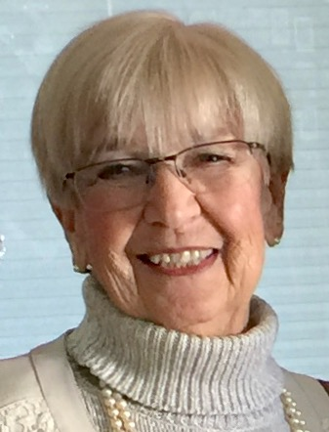
Questions? Comments? Further thoughts?
Contact me:
Contact me:
Ellen D. Fiedler, Ph.D.
E-Fiedler@neiu.edu

Slide 92
10 Minute Break
Next up: Panel Discussion

Slide 93
Panel Discussion

